Slide 1
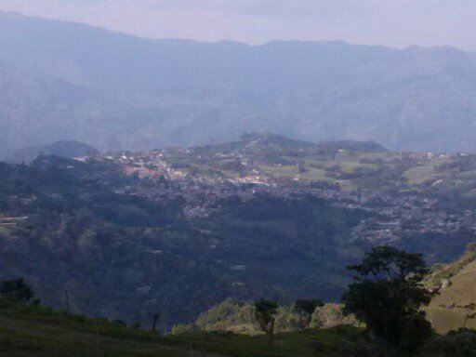
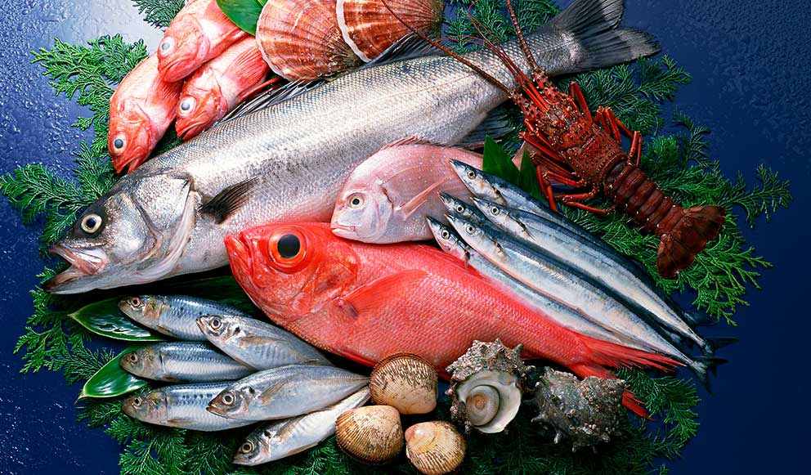
SAN FRANCISQUITO 2019
JUNE MONTH OF FISH
FROM 1 (ONE)TO 8 (EIGTH):CELEBRATION OF THE PATRON FESTIVALS OF SAN FRANCISQUITO
FROM 9 (NINE) AT 12 (TWELVE): ENJOY IN THIS WEEK THE VARIETY OF OUR FISH (OF SEA AND RIVER)
FROM 13(THIRTEEN) AT 19(FOURTEEN): COME AND ENJOY THESE SEVEN OF FISHING, DARE TO SIN THE FAMOUS FISH SANFRANCISQUITO
FROM 29(TWENTY-NINE) AT 31(THIRTY): REGISTER AND PARTICIPATE IN THE WORLD FISHING CHAMPIONSHIP
FROM 20 (TWENTY ) AT 24(TWENTY-FOUR): COME AND ENJOY FIVE DAYS OF EXTREME AQUATIC SPORTS
FROM 25(TWENTY-FIVE) AT 28(TWENTY-EIGHT): FOUR DAYS OF NATIONAL CHAMPIONSHIP IN THE PREPARATION OF THE BEST FISH

Slide 2
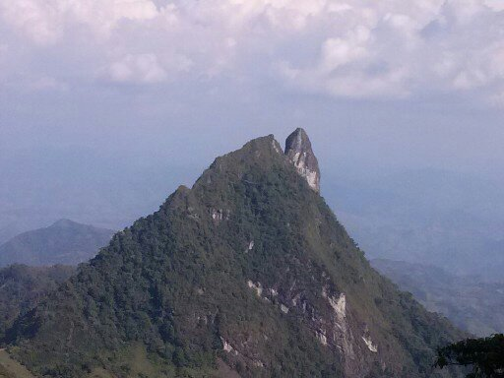
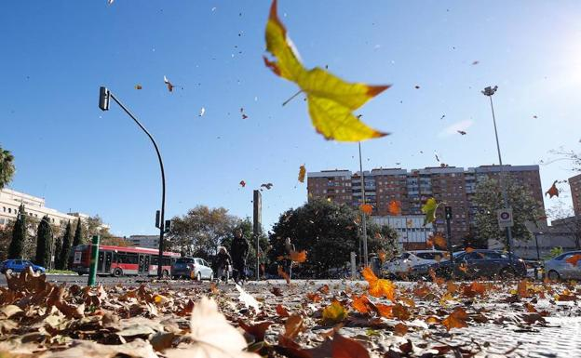
SAN FRANCISQUITO 2019
FROM 1 (ONE)TO 8 (EIGTH): CELEBRATION WEEK OF THE COMET
FROM 9 (NINE)TO 15 (FIFTEEN): WEEK OF PARAGRAPH
JULY MONTH OF WIND
FROM 16 (SIXTEEN)TO 23 (TWENTY THREE): WORLD CHAMPIONSHIP EXTREME CONQUEST OF THE HEAVENS
FROM 24 (TWENTY FOUR)TO 31 (THIRTY ONE): WEEK OF KITESURFING

Slide 3

hello my name is froilan sabogal, my favorite animal is the lion because it symbolizes towards oneself and others, it is also that animal that cares for its herd regardless of the consequences. I really want to meet you in your habitat.

Slide 4
JUNE 2019 MONTH OF FISH
MONDAY | TUESDAY | WEDNESDAY | THUESDAY | FRIDAY | SATURDAY | SUNDAY
 |  |  |  |  | 1ST CELEBRATION OF THE PATRON FESTIVALS OF SAN FRANCISQUITO | 2ND CELEBRATION OF THE PATRON FESTIVALS OF SAN FRANCISQUITO
3RD CELEBRATION OF THE PATRON FESTIVALS OF SAN FRANCISQUITO | 4TH CELEBRATION OF THE PATRON FESTIVALS OF SAN FRANCISQUITO | 5TH CELEBRATION OF THE PATRON FESTIVALS OF SAN FRANCISQUITO | 6TH CELEBRATION OF THE PATRON FESTIVALS OF SAN FRANCISQUITO | 7TH CELEBRATION OF THE PATRON FESTIVALS OF SAN FRANCISQUITO | 8TH CELEBRATION OF THE PATRON FESTIVALS OF SAN FRANCISQUITO | 9TH ENJOY IN THIS WEEK THE VARIETY OF OUR FISH (OF SEA AND RIVER)
10TH ENJOY IN THIS WEEK THE VARIETY OF OUR FISH (OF SEA AND RIVER) | 11TH ENJOY IN THIS WEEK THE VARIETY OF OUR FISH (OF SEA AND RIVER) | 12 TH ENJOY IN THIS WEEK THE VARIETY OF OUR FISH (OF SEA AND RIVER) | 13 TH COME AND ENJOY THESE SEVEN OF FISHING, DARE TO SIN THE FAMOUS FISH SANFRANCISQUITO | 14 TH COME AND ENJOY THESE SEVEN OF FISHING, DARE TO SIN THE FAMOUS FISH SANFRANCISQUITO | 15 TH COME AND ENJOY THESE SEVEN OF FISHING, DARE TO SIN THE FAMOUS FISH SANFRANCISQUITO | 16 TH COME AND ENJOY THESE SEVEN OF FISHING, DARE TO SIN THE FAMOUS FISH SANFRANCISQUITO
17TH COME AND ENJOY THESE SEVEN OF FISHING, DARE TO SIN THE FAMOUS FISH SANFRANCISQUITO | 18 TH COME AND ENJOY THESE SEVEN OF FISHING, DARE TO SIN THE FAMOUS FISH SANFRANCISQUITO | 19 TH COME AND ENJOY THESE SEVEN OF FISHING, DARE TO SIN THE FAMOUS FISH SANFRANCISQUITO | 20 THCOME AND ENJOY FIVE DAYS OF EXTREME AQUATIC SPORTS | 21 TH COME AND ENJOY FIVE DAYS OF EXTREME AQUATIC SPORTS | 22 TH COME AND ENJOY FIVE DAYS OF EXTREME AQUATIC SPORTS | 23 TH COME AND ENJOY FIVE DAYS OF EXTREME AQUATIC SPORTS
24THCOME AND ENJOY FIVE DAYS OF EXTREME AQUATIC SPORTS | 25TH FOUR DAYS OF NATIONAL CHAMPIONSHIP IN THE PREPARATION OF THE BEST FISH | 26TH FOUR DAYS OF NATIONAL CHAMPIONSHIP IN THE PREPARATION OF THE BEST FISH | 27TH FOUR DAYS OF NATIONAL CHAMPIONSHIP IN THE PREPARATION OF THE BEST FISH | 28TH FOUR DAYS OF NATIONAL CHAMPIONSHIP IN THE PREPARATION OF THE BEST FISH | 29TH REGISTER AND PARTICIPATE IN THE WORLD FISHING CHAMPIONSHIP | 30TH REGISTER AND PARTICIPATE IN THE WORLD FISHING CHAMPIONSHIP

Slide 5
JULY 2019 MONTH OF WIND
MONDAY | TUESDAY | WEDNESDAY | THUESDAY | FRIDAY | SATURDAY | SUNDAY
1ST CELEBRATION WEEK OF THE COMET | 2ND CELEBRATION WEEK OF THE COMET | 3RD CELEBRATION WEEK OF THE COMET | 4TH CELEBRATION WEEK OF THE COMET | 5TH CELEBRATION WEEK OF THE COMET | 6TH CELEBRATION WEEK OF THE COMET | 7TH CELEBRATION WEEK OF THE COMET
8TH CELEBRATION WEEK OF THE COMET | 9TH WEEK OF PARAGRAPH | 10TH WEEK OF PARAGRAPH | 11TH WEEK OF PARAGRAPH | 12 TH WEEK OF PARAGRAPH | 13 TH WEEK OF PARAGRAPH | 14 TH WEEK OF PARAGRAPH
15 TH WEEK OF PARAGRAPH | 16 TH WORLD CHAMPIONSHIP EXTREME CONQUEST OF THE HEAVENS | 17TH WORLD CHAMPIONSHIP EXTREME CONQUEST OF THE HEAVENS | 18 TH WORLD CHAMPIONSHIP EXTREME CONQUEST OF THE HEAVENS | 19 TH WORLD CHAMPIONSHIP EXTREME CONQUEST OF THE HEAVENS | 20 TH WORLD CHAMPIONSHIP EXTREME CONQUEST OF THE HEAVENS | 21TH WORLD CHAMPIONSHIP EXTREME CONQUEST OF THE HEAVENS
22 TH WORLD CHAMPIONSHIP EXTREME CONQUEST OF THE HEAVENS | 23 TH WORLD CHAMPIONSHIP EXTREME CONQUEST OF THE HEAVENS | 24TH WEEK OF KITESURFING | 25TH WEEK OF KITESURFING | 26THWEEK OF KITESURFING | 27TH WEEK OF KITESURFING | 28TH WEEK OF KITESURFING
29TH WEEK OF KITESURFING | 30TH WEEK OF KITESURFING | 31ST WEEK OF KITESURFING

